Slide 1

DEEP LEARNING:targeted attacks on speech to text…

Slide 2
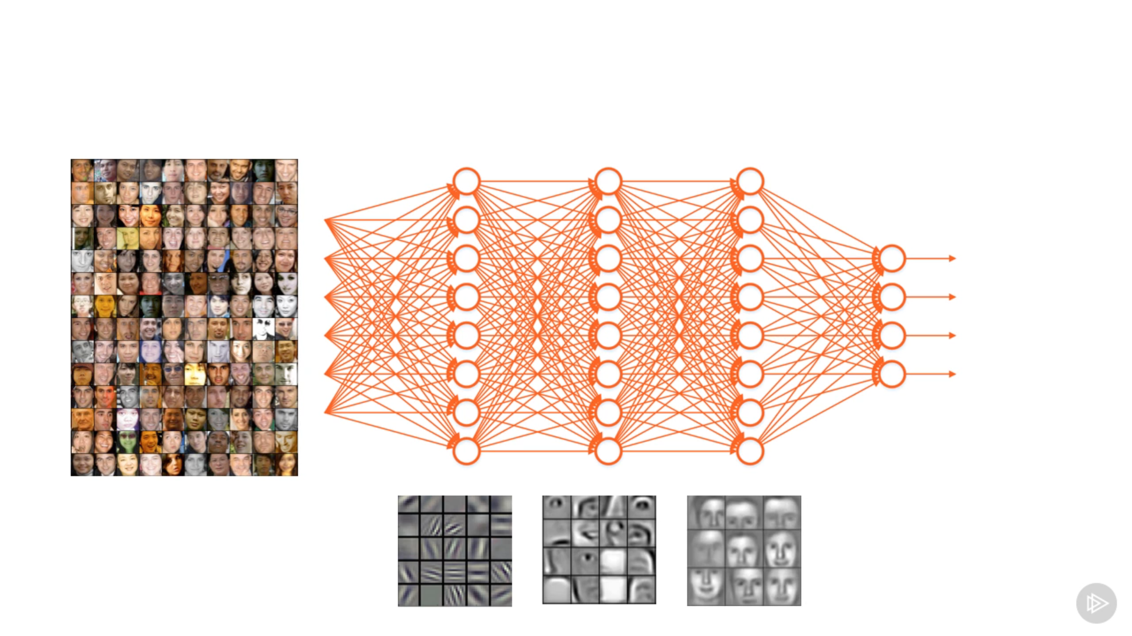
SIMPLER EXPLAINATION

Slide 3

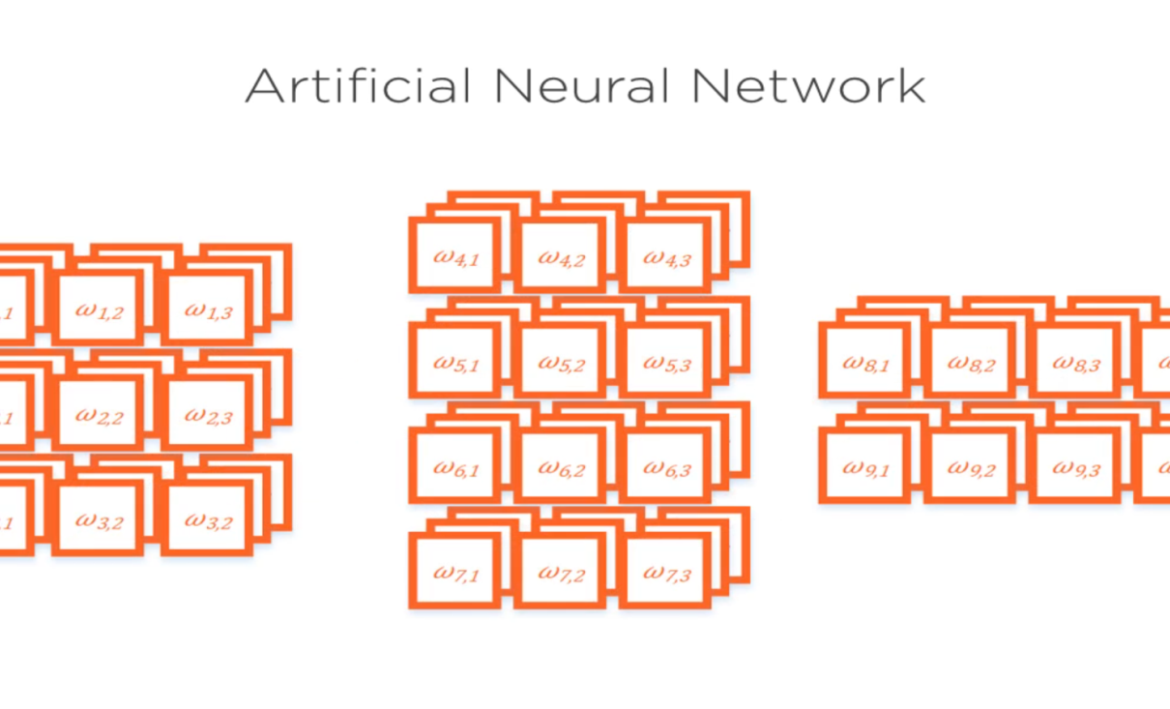
SCALARS,VECTORS AND TENSORS

Slide 4
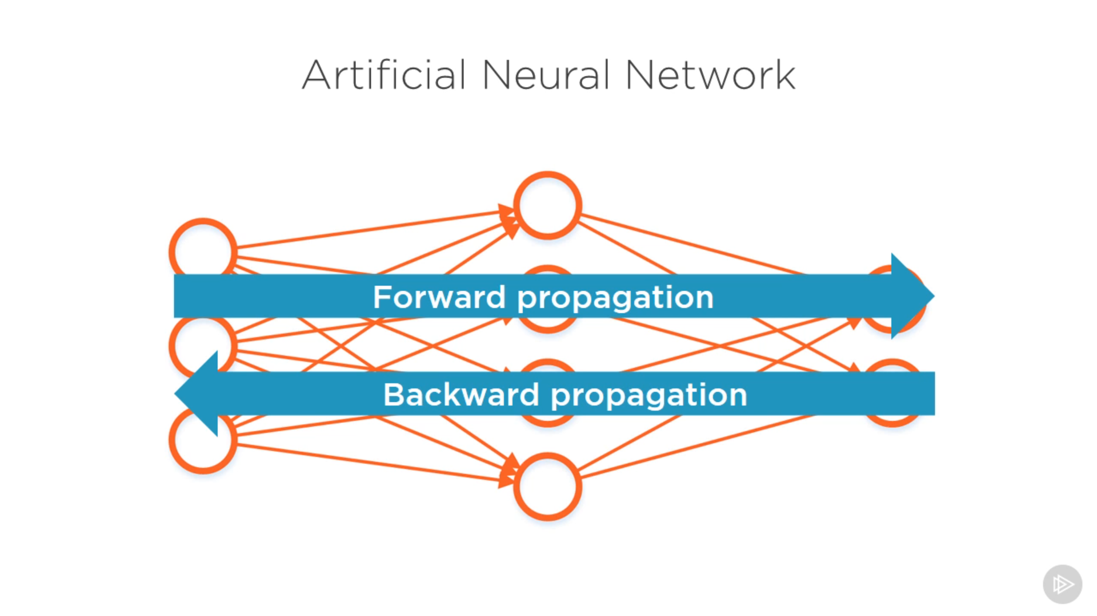

Slide 5
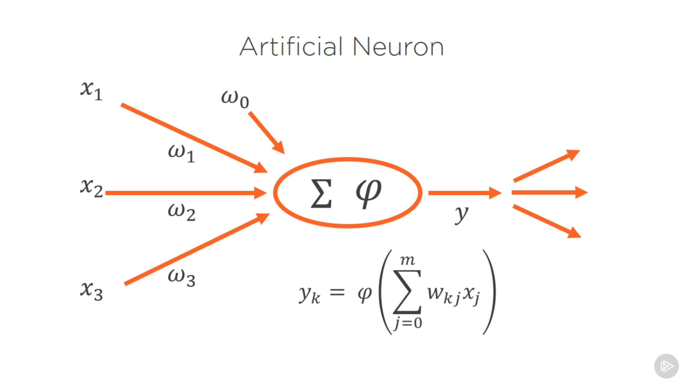

Slide 6
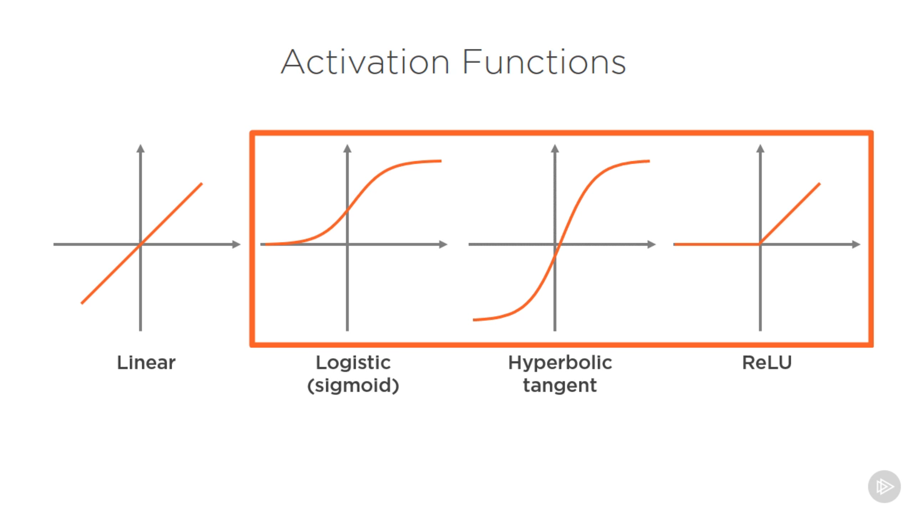

Slide 7
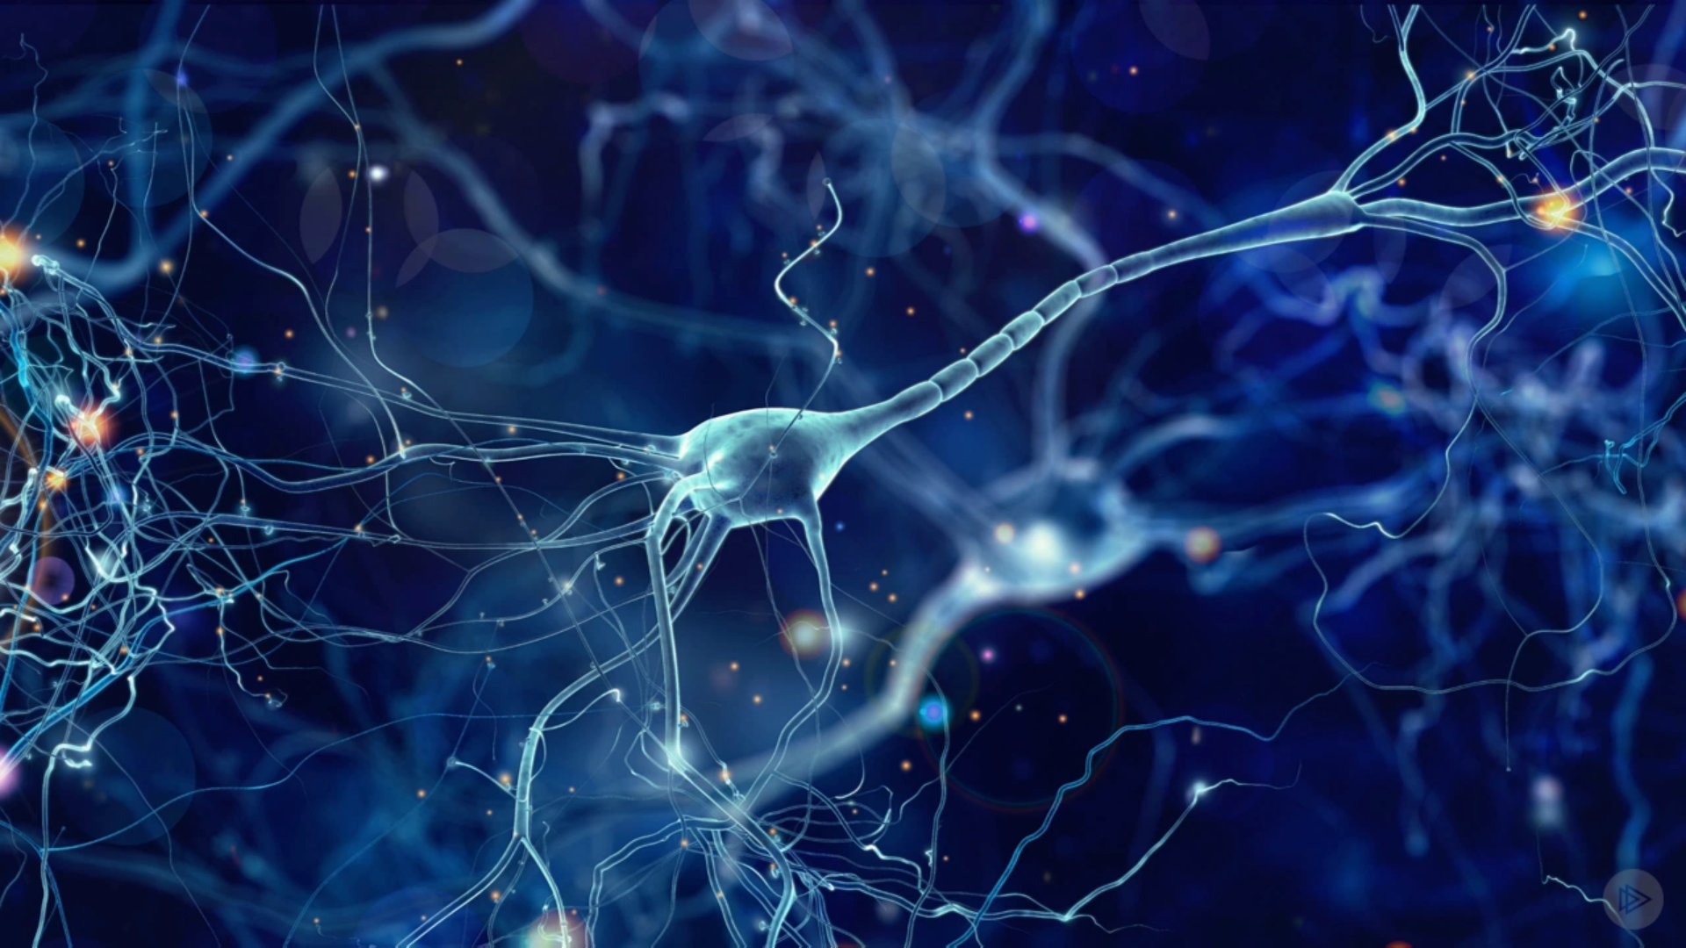
TYPES OF NEURAL NETWORKS
CNN
RNN
GAN

Slide 8

Cnn
INPUT IS AN IMAGE
OUTPUT IS TEXT…

Slide 9
APPLICATIONS
IMAGE RECOGNITION
IMAGE PROCESSING
IMAGE SEGMENTATION

Slide 10
Rnn(recurrent nueral nets)
Generally all neural networks are called feed-forward nn…
But rnn consists of feed-backs…
It produces the output based on the past experience…

Slide 11
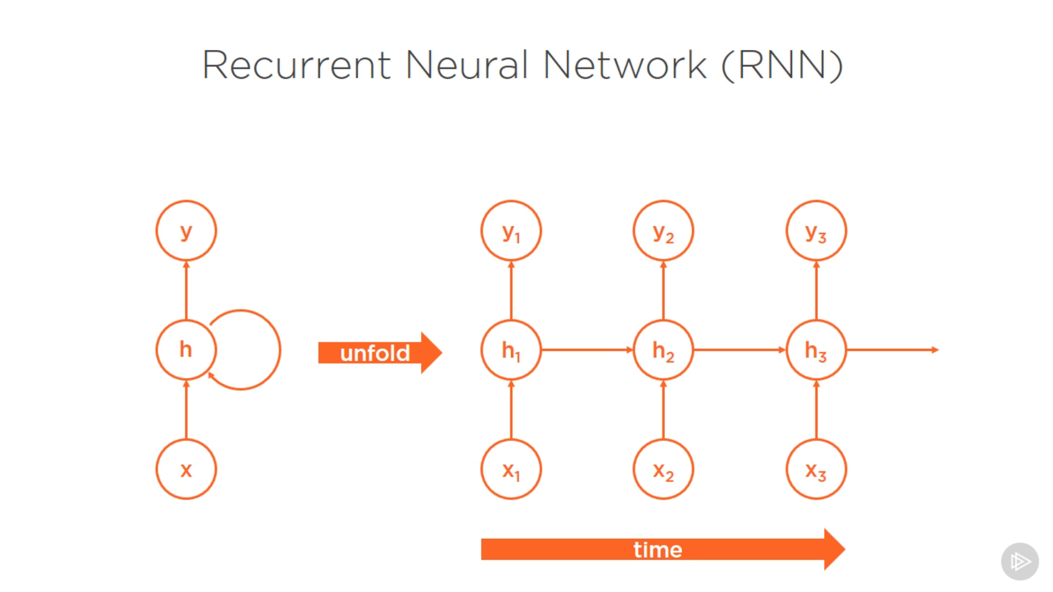

Slide 12
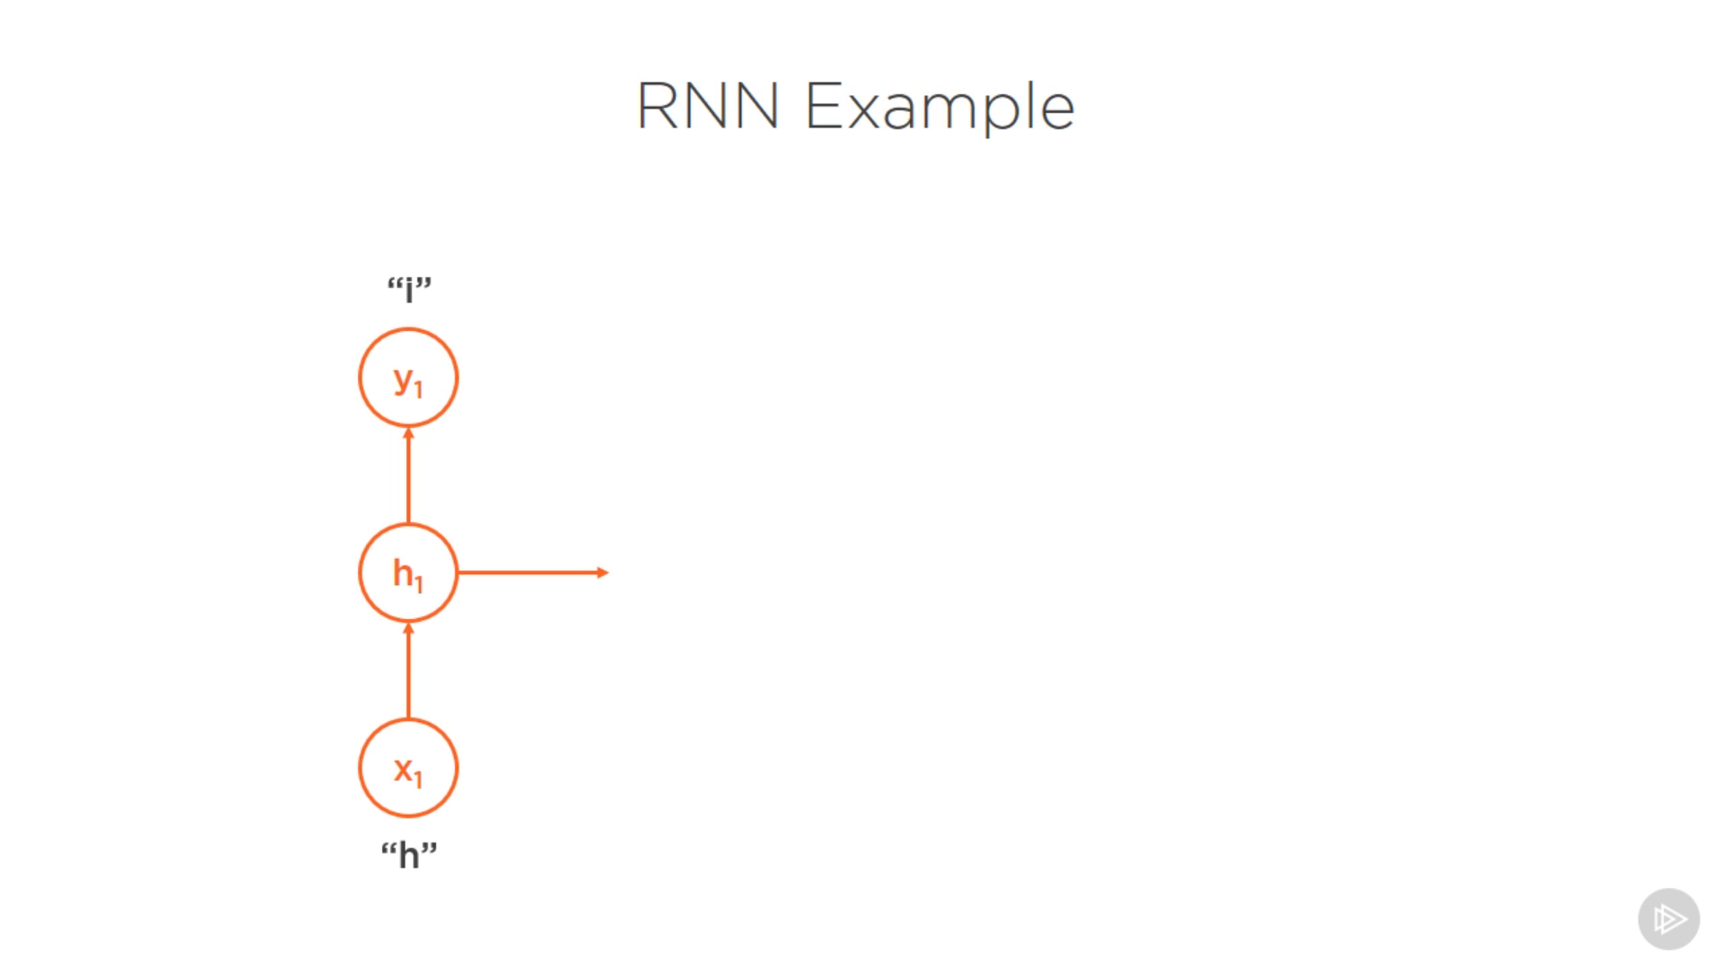

Slide 13
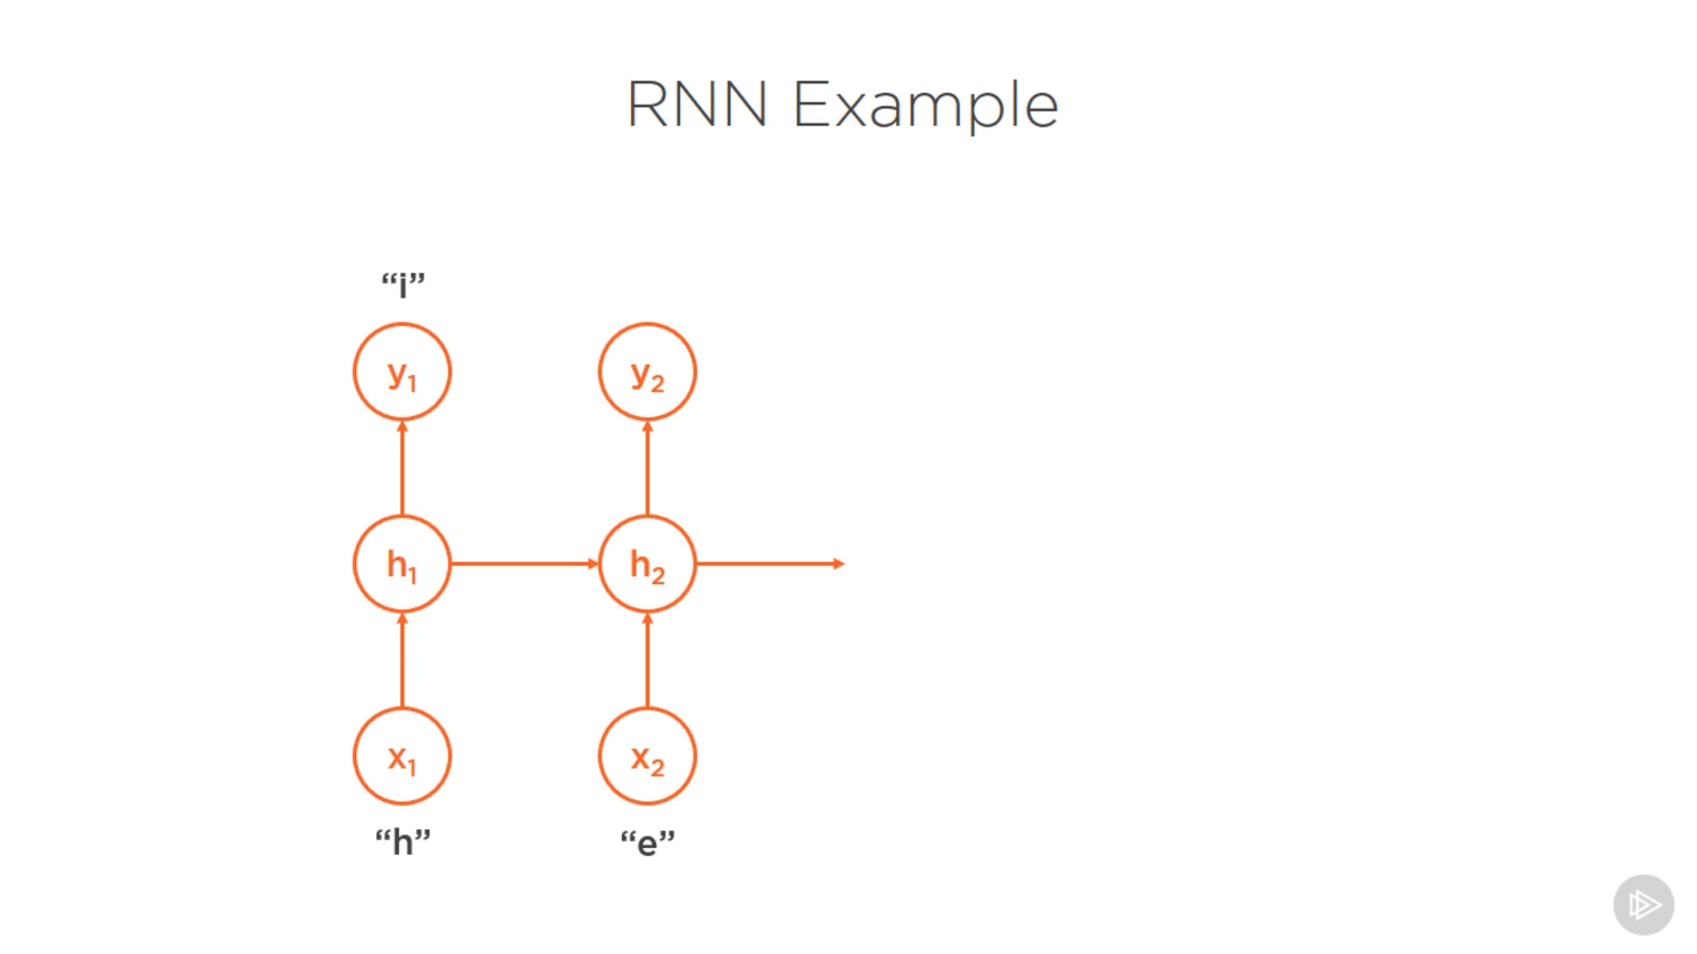

Slide 14
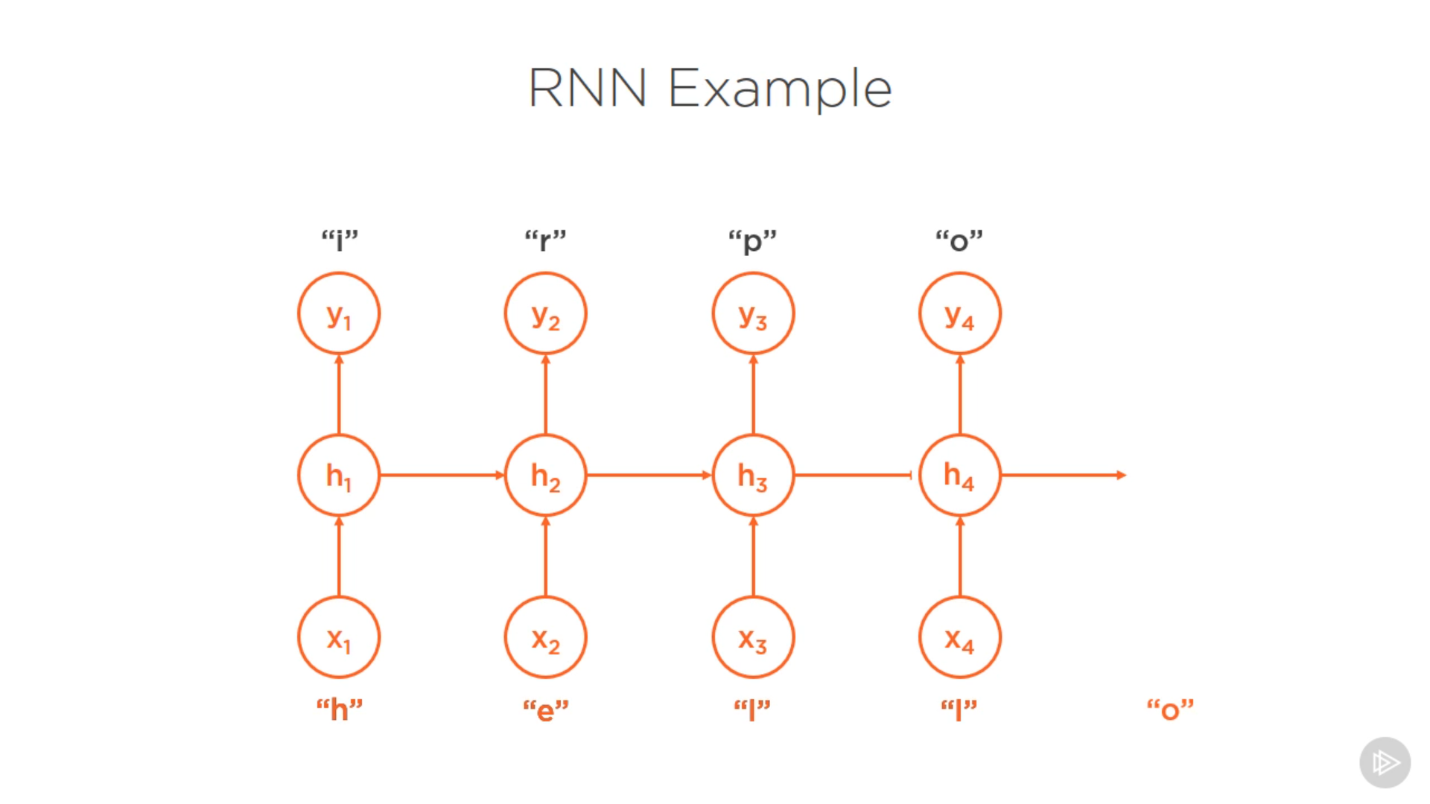

Slide 15
applications
Speech recognition’
Natural language processing
Language translation
Reccomendations….

Slide 16
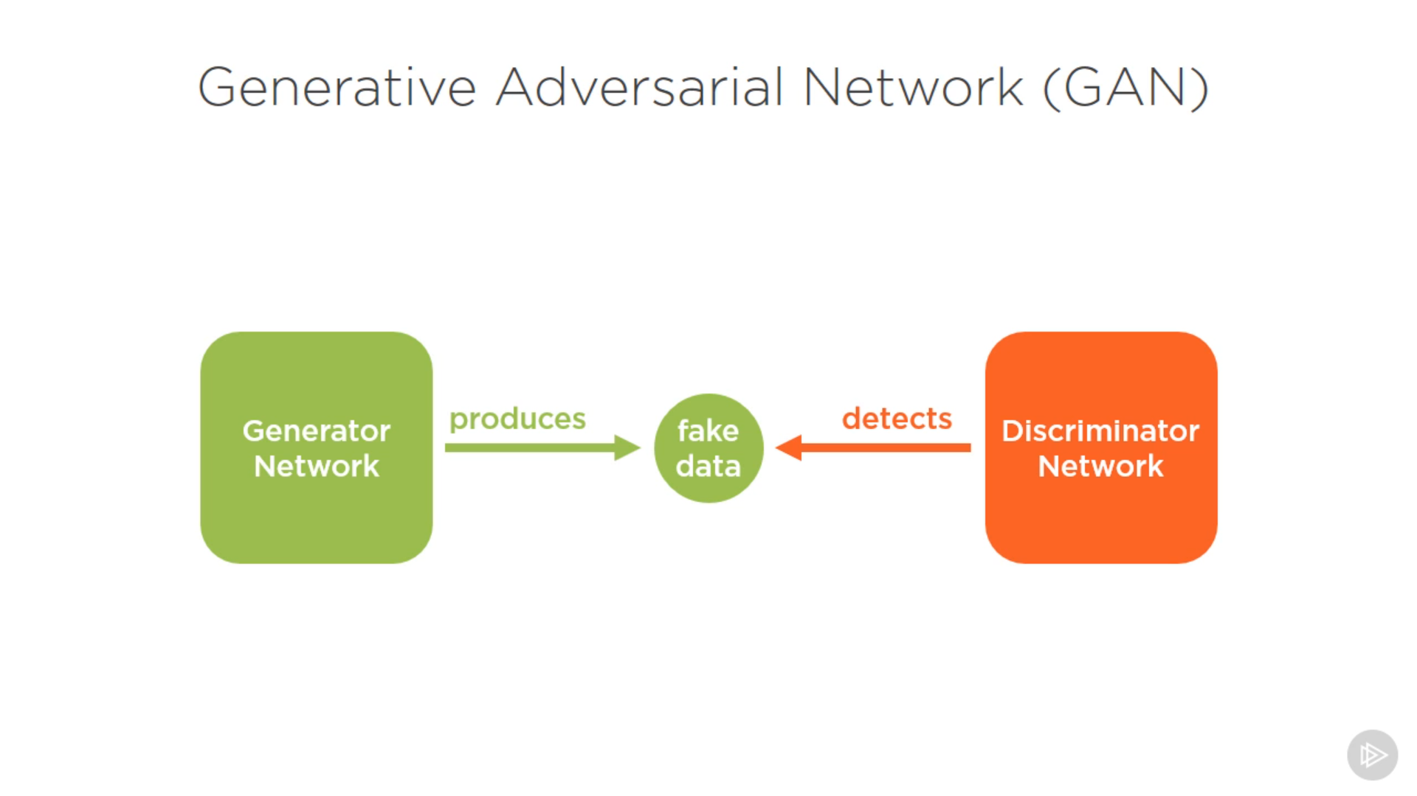

Slide 17
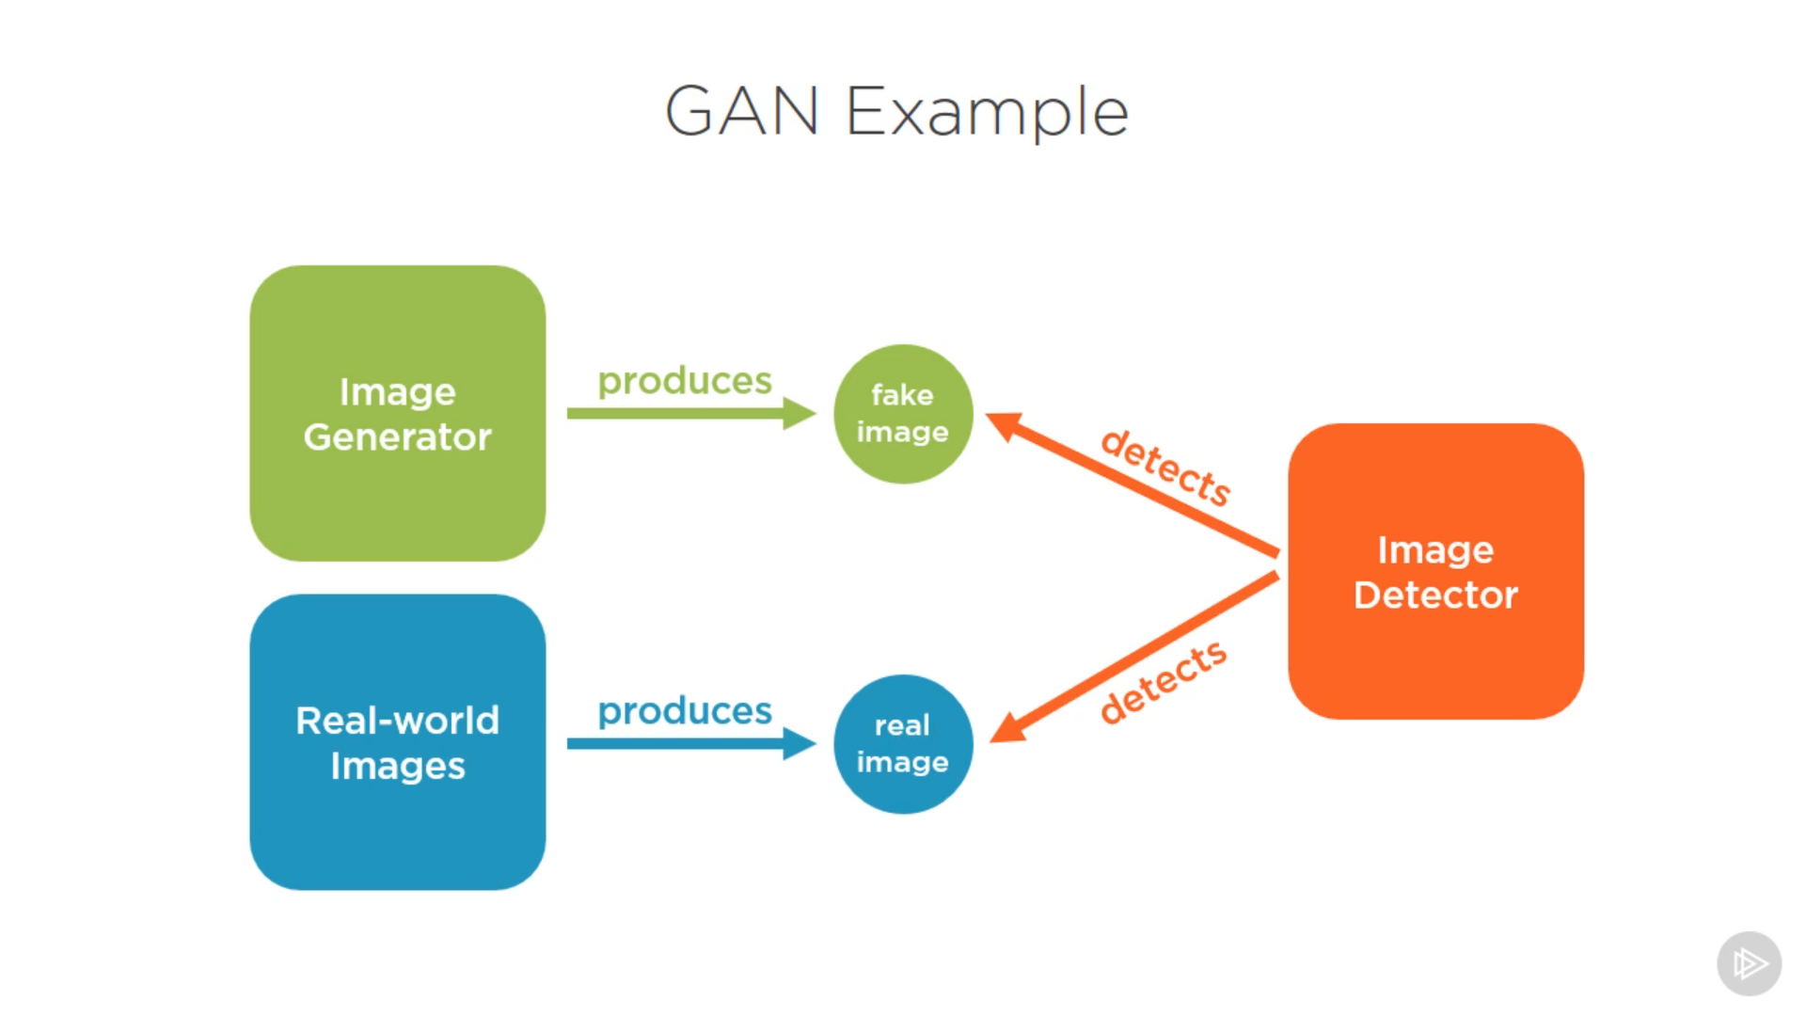

Slide 18
applications
Image generation…
Speech synthesis..

Slide 19


Slide 20
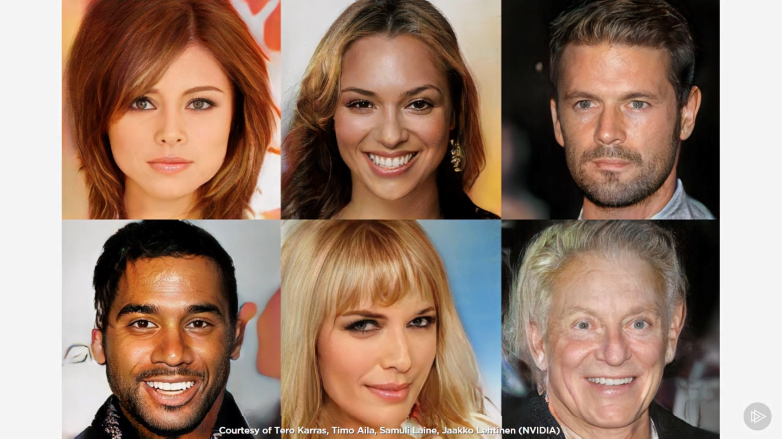

Slide 21
ABOUT THE PAPER
INPUT IS RAW AUDIO
WHICH WILL BE PASSED TO RNN
AND OUTPUT WILL BE THE TEXT

Slide 22
TRAINING THE MODEL
WE NEED HUGE CHUNKS OF AUDIO PAIRS WHICH VARIES BETWEEN 1 AND -1…

Slide 23
DIFFICUTIES IN TRAINING
PAIRS OF AUDIO ARE IN VARIABLE LENGTH..
NO ALIGNMENT BETWEEN AUDIO AND TEXT

Slide 24
OBJECTIVE OF THE PAPER
TO MINIMIZE THE LOSS BETWEEN TRAINED AUDIO AND TEXT….BY CTC LOSS..

Slide 25
INTRO TO CTC AND FORMULATION..
IT IS DIFFERENTIAL MEASURE OF DISTANCE FROM NN OUTPUT TO THE TRUE TARGETED PHRASE…
GIVEN AN INPUT X,CLASSIFIED AS F(X) = L
IT IS EASY TO FIND (BACK PROPAGATION) X’ CLOSE TO X…
SO THAT F(X’) = T…(TARGETED)

Slide 26
REFORMULATION
FORMULATION:GIVEN INPUT X,WE NEED
FIND X’
MINIMIZE d(x , x’)
SUCH THAT F(X’) = T….
X’ IS VALID
MINIMIZE d(x,x’) + g(x’)
Such that x’ is valid …
Where g(x’) is some function close such that
G(x’) is small if f(x’) = T…

Slide 27
REFORMULATION-2
G(x’) is large if f(x’)! = T…
So what is this g(x’)???
G(X’) is ctc loss function…

Slide 28
Final reformulation
Minimize d(x,x’) + ctc loss (x’,T)
Such that x’ is valid…
Only variable is ctc loss(x’,T)…

Slide 29
THANK YOU

